Slide 1
Module 2: Software Process Model
Software Engineering
Faculty of Computing / MJIIT
Universiti Teknologi Malaysia

Slide 2
Outline
Software process
  Plan-driven and Agile process
Software process models
  Waterfall model
  Incremental model (inc. Boehm’s Spiral model)
  Integration and configuration
  The Rational Unified Process (RUP)
Process activities
Coping with change
Process improvement
Note: The overall contents of the slide are based on the main reference that is Sommerville (2016) with other references specified directly in respective slides

Slide 3
Objectives
The objectives of this module are:
To understand software process, its activities and diverse software process models
To recognise the relation between plan-driven and Agile process
To differentiate the differences among software process models and their uses
To understand spiral model for coping changes and the Rational Unified Process

Slide 4
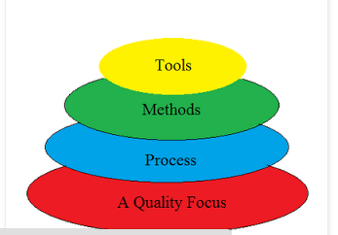
Recap: What is Software Engineering?
Software Engineering as Layered Technology
Quality Focus: The bedrock that supports software engineering is quality focus where it ensures continuous process improvement culture.
Process :Foundation for software engineering which enables rational and timely development of computer software
Methods: provide technical how to’s for building software. Involve different tasks including requirements analysis, design, program construction, testing and support. Methods also include modeling activities
Tools: provide automated or semi-automated support for the process and methods
Focus
** The layered technology will be the focus in this lecture and throughout the semester
Source:
Agarwal, U. (2019). Software Engineering, Kataria and Sons.
https://www.geeksforgeeks.org/layered-technology-in-software-engineering/

Slide 5
Software Process

Slide 6
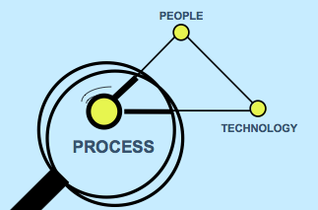
The Role of Process
Even the finest people cannot perform at their best when the process is not understood or operating at its best
    ©2009 J. L. Díaz-Herrera

Slide 7
The Software Process
A structured set of activities required to develop a
software system
Many different software processes but all involve (SDIVE):
  Specification – defining what the system should do
  Design and Implementation – defining the organization of the system and implementing the system
  Validation – checking that it does what the customer wants
  Evolution – changing the system in response to changing customer needs
A software process model is an abstract representation of a process. It presents a description of a process from some particular perspectives.

Slide 8
Software Process Descriptions
When we describe and discuss processes, we usually talk about the activities in these processes such as specifying a data model, designing a user interface and the ordering of these activities
Process descriptions may also include:
  Products, which are the outcomes of a process activity
  Roles, which reflect the responsibilities of the people involved in the process
  Pre- and post-conditions, which are statements that are true before and after a process activity has been enacted or a product produced

Slide 9
Process Descriptions
Input
PROCESS
Output
Pre-condition (if any)
Product
Post-condition (if any)
Roles

Slide 10
Plan-Driven and Agile Processes
Plan-driven processes are processes where all of the process activities are planned in advance and progress is measured against this plan
In agile processes, planning is incremental, and it is easier to change the process to reflect changing customer requirements
In practice, most practical processes include elements of both plan-driven and agile approaches
There are no right or wrong software processes

Slide 11
Software Process Models

Slide 12
Software Process Models
(1) The waterfall model
  Plan-driven model, separate and distinct phases of specification and development
(2) Incremental development
  Specification, development and validation are interleaved; may be plan-driven or agile
(3) Integration and configuration
  The system is assembled from existing components; may be plan-driven or agile.
In practice, most large systems are developed using a process that incorporates elements from all of these models

Slide 13
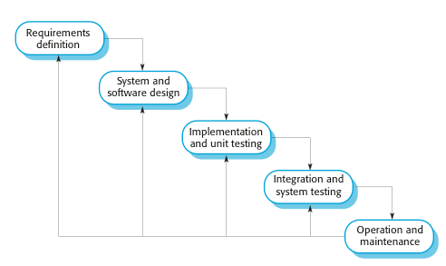
(1) The Waterfall Model

Slide 14
Waterfall Model Phases
There are separate identified phases in the waterfall model:
  Requirements analysis and definition
  System and software design
  Implementation and unit testing
  Integration and system testing
  Operation and maintenance
The main drawback of the waterfall model is the difficulty of accommodating change after the process is underway
In principle, a phase has to be complete before moving onto the next phase

Slide 15
Waterfall Model Problems
Inflexible partitioning of the project into distinct stages makes it difficult to respond to changing customer requirements
  Therefore, this model is only appropriate when the requirements are well-understood and changes will be fairly limited during the design process
  Few business systems have stable requirements
The waterfall model is mostly used for embedded systems (software must interface with hardware), critical systems, and large systems (system is developed at several sites)
  In those circumstances, the plan-driven nature of the waterfall model helps coordinate the work

Slide 16
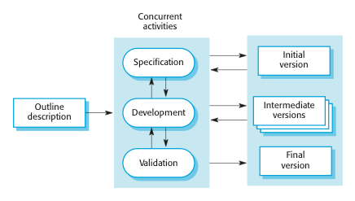
(2) Incremental Development

Slide 17
Incremental Development
In a plan-driven approach, the system increments are identified in advance
If an agile approach is adopted, the early increments are identified, but the development of later increments depends on progress and customer priorities
Each increment or version of the system incorporates some of the functionality that is needed by the customer
Generally, the early increments of the system include the most important or most urgently required functionality.

Slide 18
Incremental Development Benefits
The cost of accommodating changing customer requirements is reduced
  The amount of analysis and documentation that has to be redone is much less than is required with the waterfall model
It is easier to get customer feedback on the development work that has been done
  Customers can comment on demonstrations of the software and see how much has been implemented
More rapid delivery and deployment of useful software to the customer is possible
  Customers are able to use and gain value from the software earlier than is possible with a waterfall process

Slide 19
Incremental Development Problems
The process is not visible
  Managers need regular deliverables to measure progress
  If systems are developed quickly, it is not cost-effective to produce documents that reflect every version of the system
System structure tends to degrade as new increments are added
  Unless time and money is spent on refactoring to improve the software, regular change tends to corrupt its structure
  Incorporating further software changes becomes increasingly difficult and costly

Slide 20
Boehm’s Spiral Model
Process is represented as a spiral rather than as a sequence of activities with backtracking
Each loop in the spiral represents a phase in the process
No fixed phases such as specification or design
  loops in the spiral are chosen depending on what is required
Risks are explicitly assessed and resolved throughout the process

Slide 21
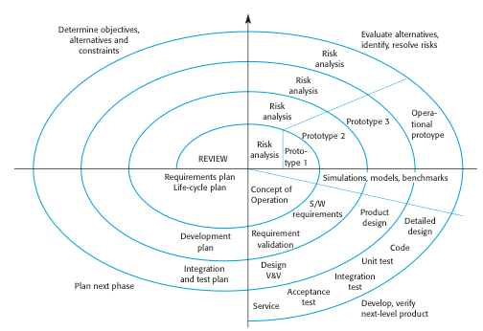
Boehm’s Spiral Model of the Software Process

Slide 22
Spiral Model Sectors
Objective setting
  Specific objectives for the phase are identified
Risk assessment and reduction
  Risks are assessed and activities put in place to reduce the key risks
Development and validation
  A development model for the system is chosen which can be any of the generic models
Planning
  The project is reviewed and the next phase of the spiral is planned

Slide 23
Spiral Model Usage
Spiral model has been very influential in helping people think about iteration in software processes and introducing the risk-driven approach to development
In practice, however, the model is rarely used as published for practical software development

Slide 24
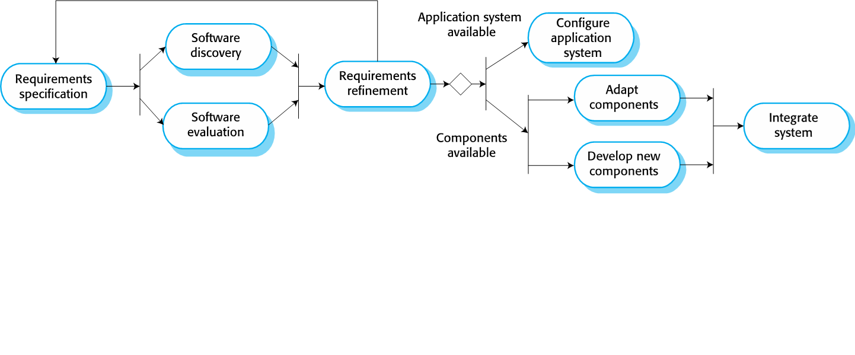
(3) Integration and configuration

Slide 25
Integration and configuration
Based on systematic reuse where systems are integrated from existing components or COTS (Commercial-off-the-shelf) systems
Process stages:
  Requirements specification
  Software discovery and evaluation
  Requirements refinement
  Application system configuration
  Component adaptation and integration
Reuse is now the standard approach for building many types of business system

Slide 26
Types of Reusable Software Components
Web services that are developed according to service standards and which are available for remote invocation
Collections of objects that are developed as a package to be integrated with a component framework such as .NET or J2EE
Stand-alone software systems (COTS) that are configured for use in a particular environment

Slide 27
Extra: Rational Unified Process (RUP)
A modern generic process derived from the work on the UML and associated process
Brings together aspects of the 3 generic process models discussed previously
Normally described from 3 perspectives:
  A dynamic perspective that shows phases over time
  A static perspective that shows process activities
  A practice perspective that suggests good practice

Slide 28
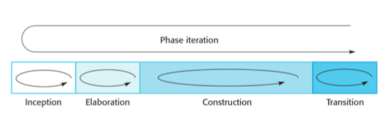
Phases in the RUP

Slide 29
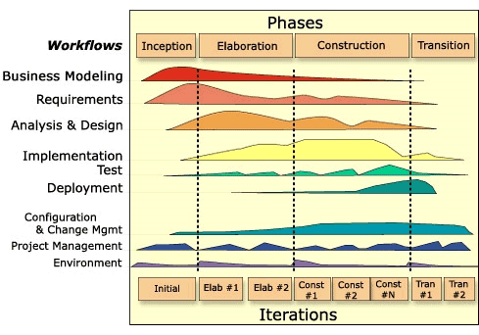
Iterative and Incremental Process in RUP

Slide 30
RUP Phases
Inception
  Establish the business case for the system
Elaboration
  Develop an understanding of the problem domain and the system architecture
Construction
  System design, programming and testing
Transition
  Deploy the system in its operating environment

Slide 31
RUP Iteration
In-phase iteration
  Each phase is iterative with results developed incrementally
Cross-phase iteration
  As shown by the loop in the RUP model, the whole set of phases may be enacted incrementally

Slide 32
Static Workflows in the RUP…
Workflow | Description
Business modelling | The business processes are modelled using business use cases.
Requirements | Actors who interact with the system are identified and use cases are developed to model the system requirements.
Analysis and Design | A design model is created and documented using architectural models, component models, object models and sequence models.
Implementation | The components in the system are implemented and structured into implementation sub-systems. Automatic code generation from design models helps accelerate this process.

Slide 33
Static Workflows in the RUP
Workflow | Description
Testing | Testing is an iterative process that is carried out in conjunction with implementation. System testing follows the completion of the implementation.
Deployment | A product release is created, distributed to users and installed in their workplace.
Configuration and Change Management | This supporting workflow manages changes to the system.
Project Management | This supporting workflow manages the system development.
Environment | This workflow is concerned with making appropriate software tools available to the software development team.

Slide 34
RUP Good Practice…
Develop software iteratively
  Plan increments based on customer priorities and deliver highest priority increments first
Manage requirements
  Explicitly document customer requirements and keep track of changes to these requirements
Use component-based architectures
  Organize the system architecture as a set of reusable components

Slide 35
RUP Good Practice
Visually model software
  Use graphical UML models to present static and dynamic views of the software
Verify software quality
  Ensure that the software meet’s organizational quality standards
Control changes to software
  Manage software changes using a change management system and configuration management tools

Slide 36
Process Activities

Slide 37
Process Activities
Real software processes are inter-leaved sequences of technical, collaborative and managerial activities with the overall goal of specifying, designing, implementing and testing a software system
The four basic process activities of (i) specification, (ii) development, (iii) validation and (iv) evolution are organized differently in different development processes. In the waterfall model, they are organized in sequence, whereas in incremental development they are inter-leaved

Slide 38
(i) Software Specification
The process of establishing what services are required and the constraints on the system’s operation and development
Requirements engineering process:
  Feasibility study (short term)
    Is it technically and financially feasible to build the system?
  Requirements elicitation and analysis
    What do the system stakeholders require or expect from the system?
  Requirements specification
    Defining the requirements in detail
  Requirements validation
    Checking the validity of the requirements

Slide 39
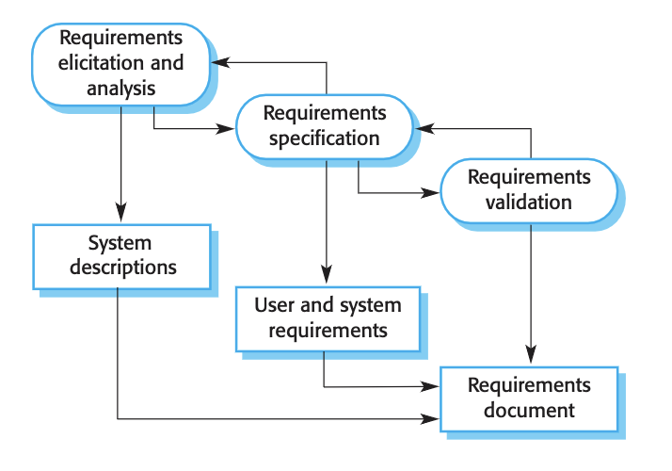
The Requirements Engineering Process

Slide 40
(ii) Software Design and Implementation
The process of converting the system specification into an executable system
Software design
  Design a software structure that realises the specification
Implementation
  Translate this structure into an executable program
The activities of design and implementation are closely related and may be inter-leaved

Slide 41
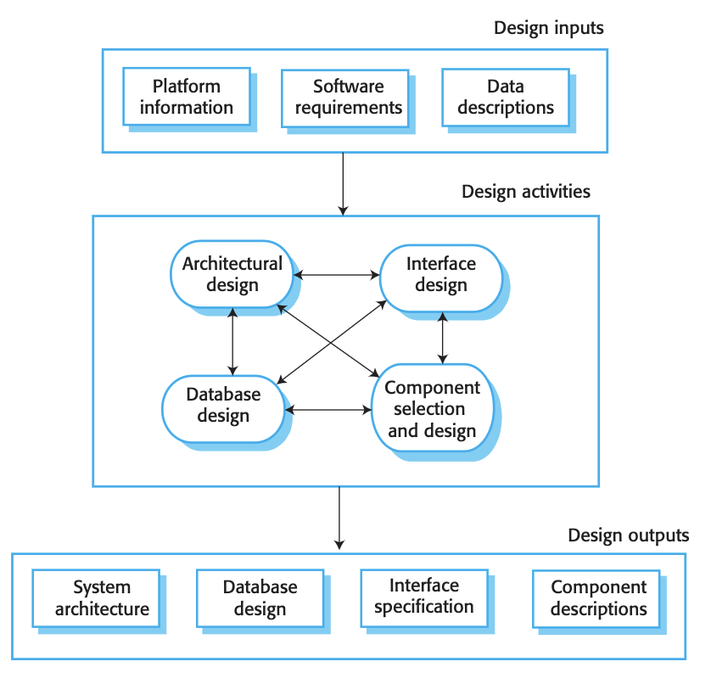
A General Model of the Design Process

Slide 42
Design Activities
Architectural design: identify the overall structure of the system, the principal components (sometimes called sub-systems or modules), their relationships and how they are distributed
Interface design: define the interfaces between system components
Component design: take each system component and design how it will operate
Database design: design the system data structures and how these are to be represented in a database

Slide 43
(iii) Software Validation
Verification and validation (V & V) is intended to show that a system conforms to its specification and meets the requirements of the system customer
Involves checking and review processes and system testing
System testing involves executing the system with test cases that are derived from the specification of the real data to be processed by the system
Testing is the most commonly used V & V activity

Slide 44
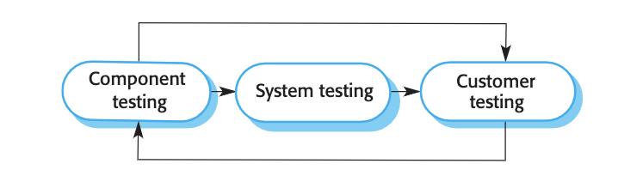
Stages of Testing

Slide 45
Testing Stages
Development or component testing
  Individual components are tested independently
  Components may be functions or objects or coherent groupings of these entities
System testing
  Testing of the system as a whole
  Testing of emergent properties is particularly important
Customer testing
  Testing with customer data to check that the system meets the customer’s needs before the system is accepted for operational use

Slide 46
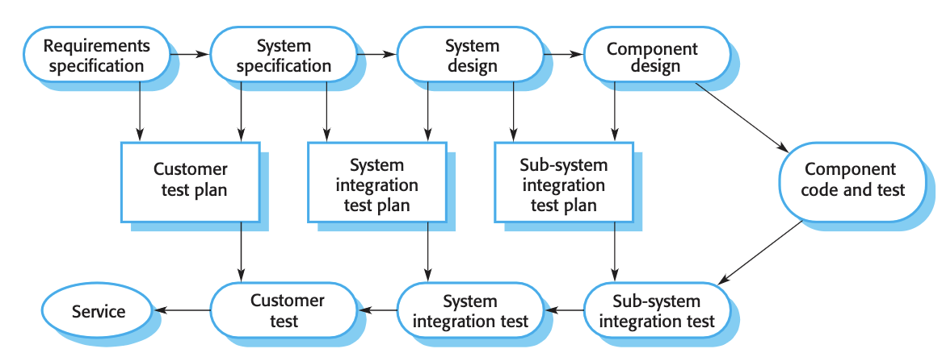
Testing Phases in a Plan-Driven Software Process

Slide 47
(iv) Software Evolution
Software is inherently flexible and can change
As requirements change through changing business circumstances, the software that supports the business must also evolve and change
Although there has been a demarcation (separation) between development and evolution (maintenance) this is increasingly irrelevant as fewer and fewer systems are completely new, and it makes much more sense to see development and maintenance as continuum

Slide 48
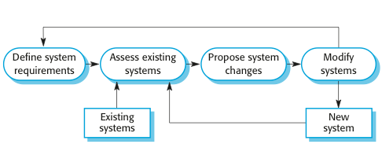
System Evolution

Slide 49
Coping with Change

Slide 50
Coping with Change
Change is inevitable in all large software projects.
  Business changes lead to new and changed system requirements
  New technologies open up new possibilities for improving implementations
  Changing platforms require application changes
Change leads to rework so the costs of change include both rework (e.g. re-analyzing requirements) as well as the costs of implementing new functionality

Slide 51
Approach to Reduce Costs of Rework
Change anticipation, where the software process includes activities that can anticipate possible changes before significant rework is required
  E.g. a prototype system may be developed to show some key features of the system to customers
Change tolerance, where the process is designed so that changes can be accommodated at relatively low cost
  This normally involves some form of incremental development, which proposed changes may be implemented in increments that have not yet been developed
  If this is impossible, then only a single increment (a small part of the system) may have be altered to incorporate the change
Notes:
Change Anticipation - previously Change Avoidance

Slide 52
Ways to cope:
(1) Software Prototyping
A prototype is an initial version of a system used to demonstrate concepts and try out design options.
A prototype can be used in:
  The requirements engineering process to help with requirements elicitation and validation;
  In design processes to explore options and develop a UI design;
  In the testing process to run back-to-back tests.

Slide 53
Benefits of Prototyping
Improved system usability
A closer match to users’ real needs
Improved design quality
Improved maintainability
Reduced development effort

Slide 54
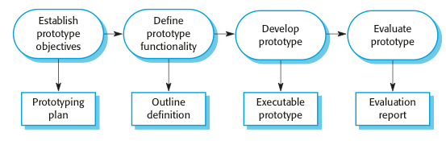
The Process of Prototype Development

Slide 55
Prototype Development
May be based on rapid prototyping languages or tools
May involve leaving out functionality:
  Prototype should focus on areas of the product that are not well-understood
  Error checking and recovery may not be included in the prototype
  Focus on functional rather than non-functional requirements such as reliability and security

Slide 56
Throw-Away Prototypes
Prototypes should be discarded after development as they are not a good basis for a production system:
  It may be impossible to tune the system to meet non-functional requirements
  Prototypes are normally undocumented
  The prototype structure is usually degraded through rapid change
  The prototype probably will not meet normal organizational quality standards

Slide 57
Ways to cope:
(2) Incremental Delivery
Rather than deliver the system as a single delivery, the development and delivery is broken down into increments with each increment delivering part of the required functionality
User requirements are prioritised and the highest priority requirements are included in early increments
Once the development of an increment is started, the requirements are frozen though requirements for later increments can continue to evolve

Slide 58
Incremental Development and Delivery
Incremental development:
  Develop the system in increments and evaluate each increment before proceeding to the development of the next increment
  Normal approach used in agile methods
  Evaluation done by user/customer proxy
Incremental delivery:
  Deploy an increment for use by end-users
  More realistic evaluation about practical use of software
  Difficult to implement for replacement systems as increments have less functionality than the system being replaced

Slide 59
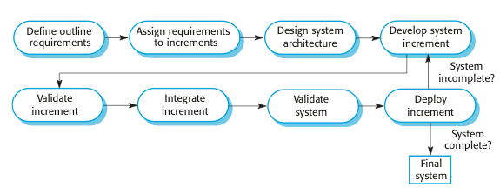
Incremental Delivery

Slide 60
Incremental Delivery Advantages
Customer value can be delivered with each increment so system functionality is available earlier
Early increments act as a prototype to help elicit requirements for later increments
Lower risk of overall project failure
The highest priority system services tend to receive the most testing

Slide 61
Incremental Delivery Problems
Most systems require a set of basic facilities that are used by different parts of the system
  As requirements are not defined in detail until an increment is to be implemented, it can be hard to identify common facilities that are needed by all increments
The essence of iterative processes is that the specification is developed in conjunction with the software
  However, this conflicts with the procurement model of many organizations, where the complete system specification is part of the system development contract

Slide 62
Process Improvement

Slide 63
Process Improvement
Many software companies have turned to software process improvement to enhance the quality of the software, reducing costs, or accelerating the development processes
Process improvement means understanding existing processes and changing these processes to increase product quality and/or reduce costs and development time.

Slide 64
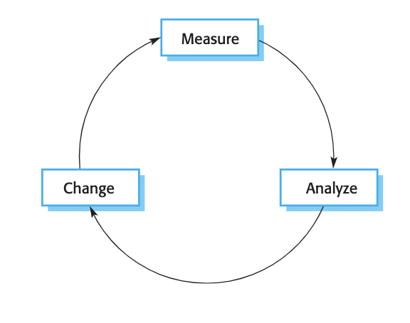
Process Improvement Cycle

Slide 65
Process Improvement Cycle
Process measurement: measure one or more attributes of the software process or product. These measurements form a baseline that helps to decide if process improvements have been effective. As improvements are introduced, re-measure the same attributes, which will hopefully have improved in some way
Process analysis: The current process is assessed, and process weaknesses and bottlenecks are identified. Process models (sometimes called process maps) that describe the process may be developed during this stage. The analysis may be focused by considering process characteristics such as rapidity and robustness.
Process change: Change are proposed to address some of the identified process weaknesses. These are introduced, and the cycle resumes to collect data about the effectiveness of the changes.

Slide 66
2 Approaches
Process maturity approach
  focus on improving process and project management and introducing good software engineering practice into an organization
  The level of process maturity reflects the extent to which good technical and management practice has been adopted in organizational software development processes
  The primary goals of this approach are improved product quality and process predictability
Agile approach
  focus on iterative development and the reduction of overheads in the software process
  The primary characteristics are rapid delivery of functionality and responsiveness to changing customer requirements
  The improvement philosophy: the best processes are those with the lowest overheads and agile approaches can achieve this

Slide 67
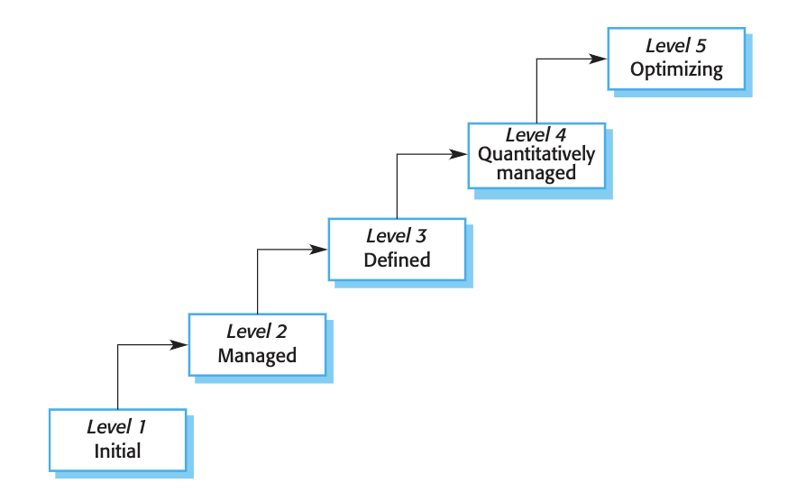
Capability Maturity Levels

Slide 68
Capability Maturity Levels
Initial: The goals associated with the process area are satisfied, and for all processes the scope of the work to be performed is explicitly set out and communicated to the team members.
Managed: At this level, the goals associated with the process area are met, and organizational policies are in place that define when each process should be used. There must be documented project plans that define the project goals. Resource management and process monitoring procedures must be in place across the institution.
Defined:This level focuses on organizational standardization and deployment of processes. Each project has a managed process that is adapted to the project requirements from a defined set of organizational processes. Process assets and process measurements must be collected and used for future process improvements.

Slide 69
Capability Maturity Levels
Quantitatively managed: At this level, there is an organizational responsibility to use statistical and other quantitative methods to control subprocesses. That is, collected process and product measurements must be used in process management.
Optimizing: At this highest level, the organization must use the process and product measurements to drive process improvement. Trends must be analyzed and the processes adapted to changing business needs.

Slide 70
Key Points…
Software processes are the activities involved in producing a software system. Software process models are abstract representations of these processes.
General process models describe the organization of software processes. Examples of these general models include the ‘waterfall’ model, incremental development, and reuse-oriented development.
The Rational Unified Process is a modern generic process model that is organized into phases (inception, elaboration, construction and transition) but separates activities (requirements, analysis and design, etc.) from these phases.

Slide 71
Key Points…
Requirements engineering is the process of developing a software specification.
Design and implementation processes are concerned with transforming a requirements specification into an executable software system.
Software validation is the process of checking that the system conforms to its specification and that it meets the real needs of the users of the system.
Software evolution takes place when you change existing software systems to meet new requirements. The software must evolve to remain useful.

Slide 72
Key Points
Processes should include activities to cope with change. This may involve a prototyping phase that helps avoid poor decisions on requirements and design.
Processes may be structured for iterative development and delivery so that changes may be made without disrupting the system as a whole.
Process improvement to enhance the quality of the software, reducing costs, or accelerating the development processes

